Slide 1
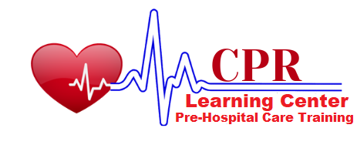
Bloodborne Pathogens
OSHA 10-hour Outreach Training
General Industry
Instructor: Haitham Rabadi

Slide 2
Introduction
Lesson objectives:
Define bloodborne pathogens.
Identify workers who are at risk of exposure to bloodborne pathogens.
Identify key aspects of a Bloodborne Pathogen Exposure Control Plan;
Describe methods for controlling exposure to bloodborne pathogens.
Describe steps to take when exposed to a bloodborne pathogen.

Slide 3
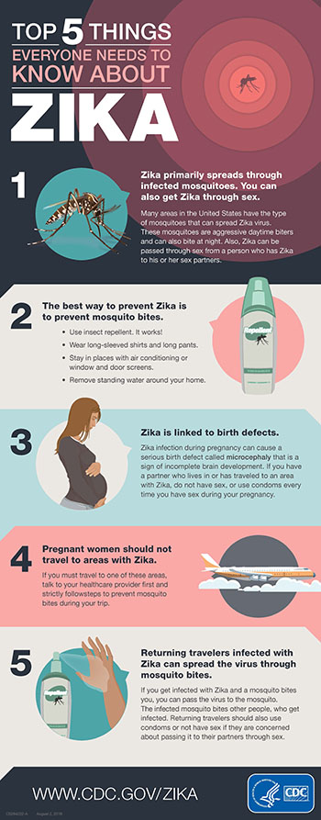
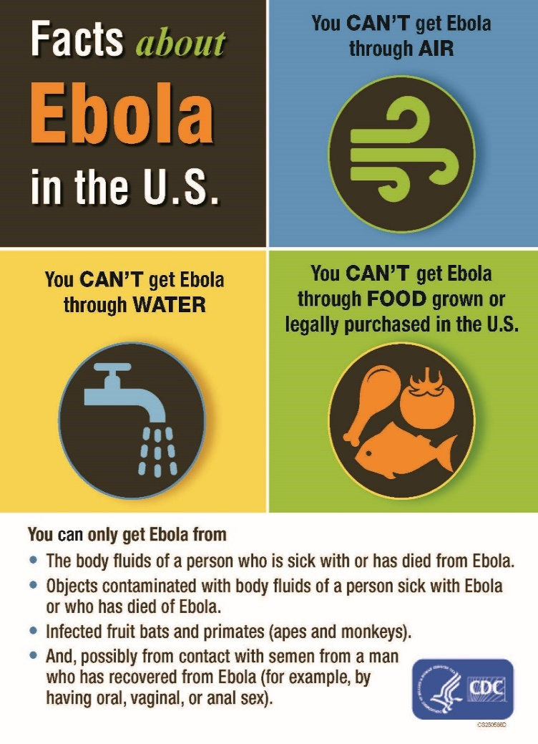
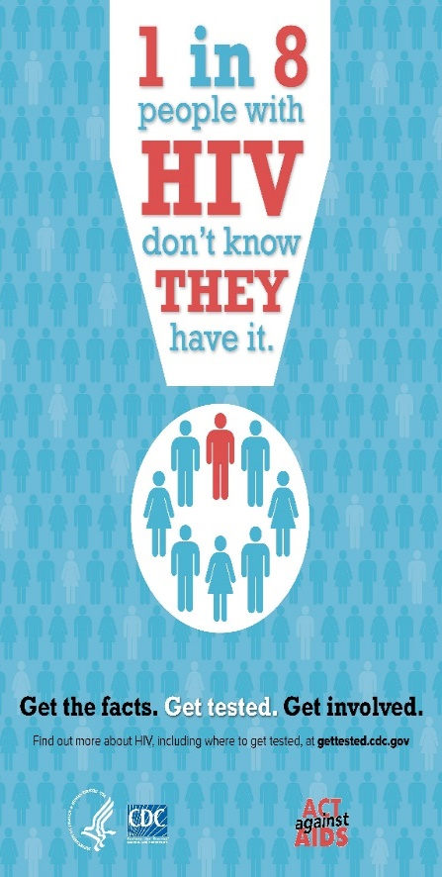
Introduction
2016
2014
1981
Notes:
Over the years, there have been outbreaks of diseases around the world. Three examples of outbreaks that have affected the U.S. include the 1981 outbreak of HIV, the 2014 outbreak of Ebola, and, most recently, the 2016 outbreak of the Zika virus. All three are examples of diseases that can spread through contact with infected blood or other bodily fluids.
The CDC estimates that 5.6 million workers in the healthcare industry and related occupations are at risk of occupational exposure to bloodborne pathogens, including human immunodeficiency virus (HIV), hepatitis B virus (HBV), hepatitis C virus (HCV), and others. All occupational exposure to blood or other potentially infectious materials (OPIM) places workers at risk for infection from bloodborne pathogens.

Slide 4
Bloodborne Pathogens
What are bloodborne pathogens?
Pathogenic microorganisms present in human blood that can lead to diseases
Examples of primary concern
  Hepatitis B (HBV)
  Hepatitis C (HCV)
  Human Immunodeficiency Virus (HIV)
Notes:
Bloodborne pathogens are infectious microorganisms in human blood that can cause disease in humans. These pathogens include, but are not limited to, hepatitis B (HBV), hepatitis C (HCV) and human immunodeficiency virus (HIV). Needlesticks and other sharps-related injuries may expose workers to bloodborne pathogens. Workers in many occupations, including first responders, housekeeping personnel in some industries, nurses and other healthcare personnel, all may be at risk for exposure to bloodborne pathogens

Slide 5
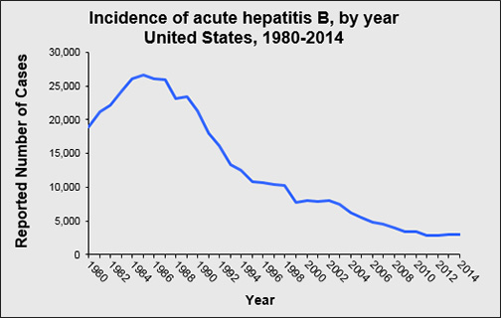
Bloodborne Pathogens
Hepatitis B (HBV)
  Over 12 million Americans are infected (1 in 20)*
  Silent infection; symptoms include jaundice, fatigue, abdominal pain, loss of appetite, intermittent nausea, vomiting; may lead to chronic liver disease, liver cancer, and death
  HBV can survive for at least
  one week in dried blood
  Up to 40,000 people in US
  will become newly infected
  each year*
*Source: Hepatitis B Foundation
Reported cases of hepatitis B in the U.S. have generally declined from 1980 to 2014. Source: CDC
Notes:
Source: CDC http://www.cdc.gov/hepatitis/hbv/index.htm
Hepatitis B Virus (HBV)
a. Causes serious liver disease (Hepatitis B), which can become a chronic condition that causes permanent scarring of liver, leading to liver failure or liver cancer; estimated 2,000-4,000 deaths per year in U.S.
b. Symptoms: fever, fatigue, loss of appetite, nausea, vomiting, abdominal pain, dark urine, joint pain, jaundice
c. HBV is much more transmissible than HIV; risk of infection from single needlestick is 6%-30% (CDC 1997)
d. 50% of infected people are unaware that they have HBV
e. HBV can survive for at least one week in dried blood on environmental surfaces or contaminated needles and instruments
The risk of health care workers being exposed to HIV on the job (occupational exposure) is very low, especially if they use protective practices and personal protective equipment to prevent HIV and other blood-borne infections. For health care workers on the job, the main risk of HIV transmission is from being stuck with an HIV-contaminated needle or other sharp object. However, even this risk is small. Scientists estimate that the risk of HIV infection from being stuck with a needle used on an HIV-infected person is less than 1%.
(Source CDC – HIV transmission)

Slide 6
Bloodborne Pathogens
Hepatitis C (HCV)
  Hepatitis C is the most common chronic bloodborne infection in the U.S.
  Symptoms include: jaundice, fatigue, abdominal pain, loss of appetite, intermittent nausea, vomiting
  May lead to chronic liver disease and death
Notes:
Source: CDC http://www.cdc.gov/hepatitis/hcv/index.htm
Hepatitis C Virus (HCV)
a. Causes chronic illness (Hepatitis C); attacks the liver and leads to inflammation; chronic infection develops in 75%-85% of patients, with 70% developing active liver disease (CDC n.d.); can result in long-term health problems, even death
b. Symptoms: fever, fatigue, loss of appetite, nausea, vomiting, abdominal pain, dark urine, joint pain, jaundice
c. Approximately 3.2 million people infected in U.S.; most have no symptoms and don’t know they are infected until decades later when liver damage shows up in routine tests.

Slide 7
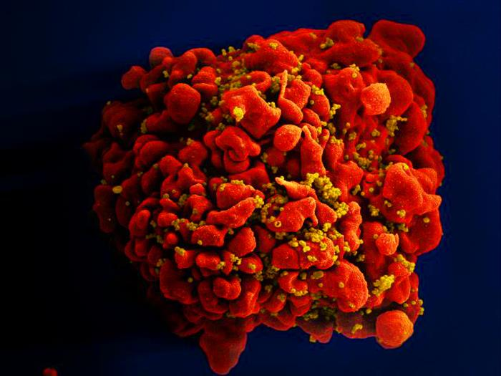
Bloodborne Pathogens
Human Immunodeficiency Virus (HIV)
  HIV is the virus that leads to AIDS
  HIV affects the body’s immune system
  HIV does not survive well outside the body
  Estimated >1.1 million people living with HIV
  Infected for life
Single, red-colored H9-T cell infected by numerous mustard-colored HIV particles which are attached to the cell’s surface membrane. Source: NIAID.
Notes:
Source: CDC http://www.cdc.gov/hiv/
Photo: https://phil.cdc.gov/phil/details.asp
Human Immunodeficiency Virus (HIV)
a. Causes Acquired Immunodeficiency Syndrome (AIDS); attacks the immune system cells, weakening and eventually destroying the immune system, and, thus, leaving the body at higher risk of
developing more serious conditions such as pneumonia or cancer; nearly 7,000 people died from HIV/AIDS in U.S. in 2013
b. Estimated that more than 1.1 million people are living with HIV; close to 1 in 5 are unaware they are infected; once infected, human body cannot get rid of the HIV completely – infected for life
c. Some people experience flu-like symptoms (fever, chills, rash, night sweats, muscle aches, sore throat, fatigue, swollen lymph nodes, or mouth ulcers) 2-4 weeks after infection, while others may
not feel sick
d. HIV does not survive long and cannot reproduce outside a human host

Slide 8
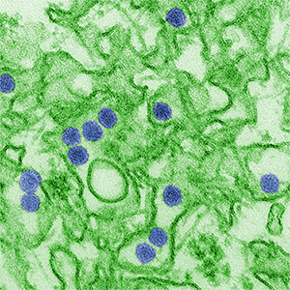
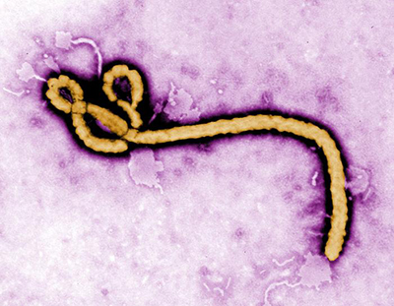
Bloodborne Pathogens
Other bloodborne diseases
  Caused by viruses or bacteria
  Circulate in blood at some phase; capable of being transmitted
  Most are rare in the U.S.
Zika Virus (left) and Ebola Virus (right) can be spread to workers through contaminated blood or infectious body fluids.
Source: CDC / C.Goldsmith
Source: CDC / F. Murphy
Notes:
Source: North Caroline Department of Labor http://www.nclabor.com/osha/etta/indguide/ig7.pdf
Other bloodborne diseases
Caused by viruses or bacteria;
Circulate in blood for prolonged periods during at least some phases and, therefore, capable of being transmitted through blood or other potentially infectious materials;
Most are rare in the U.S.

Slide 9
Bloodborne Pathogens
Examples
  Hepatitis D (HDV)
  Syphilis
  Malaria
  Babesiosis
  Brucellosis
  Leptospirosis
  Arboviral Infections
  Relapsing fever
  Creutzfeldt-Jakob Disease
  Human T-Lymphotropic Virus Type I
  Viral Hemorrahagic Fever
Notes:
This is a list of other bloodborne diseases – caused by viruses or bacteria; these circulate in blood for prolonged periods during at least some phases and, therefore, capable of being transmitted through blood or other potentially infectious materials; most are rare in the U.S.
(North Carolina Department of Labor 2010)
1. Hepatitis D (HDV)
2. Syphilis
3. Malaria
4. Babesiosis
5. Brucellosis
6. Leptospirosis
7. Arboviral infections
8. Relapsing fever
9. Creutzfeldt-Jakob disease
10. Human T-lymphotropic virus type I
11. Viral hemorrhagic fever
http://www.nclabor.com/osha/etta/indguide/ig7.pdf

Slide 10

Risk of Exposure
Contamination sources:
Blood
Other potentially infectious
materials (OPIM)
  Human body fluids
  Any unfixed tissue or organ from human
  Cultures, culture mediums, or other solutions
  Experimental animal blood, tissues, or organs infected with HIV or HBV
Source: OSHA
Notes:
Blood – human blood, human blood components, and products made from human blood
Other potentially infectious materials (OPIM) 29 CFR1910.1030(b)
a. Human body fluids
i. Semen vii. Peritoneal fluid
ii. Vaginal secretions viii. Amniotic fluid
iii. Cerebrospinal fluid ix. Saliva
iv. Synovial fluid x. Any body fluid visibly contaminated with blood
v. Pleural fluid xi. All body fluids which are difficult/impossible to differentiate between fluids
vi. Pericardial fluid
b. Any unfixed tissue or organ (other than intact skin) from a human (living or dead)
c. HIV-containing cell or tissue cultures, organ cultures, and HIV- or HBV-containing culture medium or other solutions
d. Blood, organs, or other tissues from experimental animals infected with HIV or HBV

Slide 11
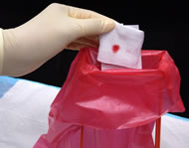
Risk of Exposure
Spread of bloodborne pathogens occurs through:
Direct contact
Indirect contact
Respiratory transmission
Vector-borne transmission
Source: NIOSH
Notes:
Source: American Red Cross (2001) http://www.in.gov/isdh/files/BBP_American_Red_Cross_Fact_Sheet_xps(1).pdf
Spread of bloodborne pathogens - primarily through:
1. Direct contact – infected blood or body fluid (mucous) from one person is transferred directly to another person
2. Indirect contact – a person touches and object that contains the blood/body fluid of an infected person
3. Respiratory transmission – person inhales respiratory droplets from an infected person (through cough or sneeze)
4. Vector-borne transmission – person’s skin is penetrated by a bite (or other means) from an organism carrying the disease (mosquitoes, ticks, etc.)
Examples of Modes of Transmission:
Contact with another person’s blood or bodily fluid that may contain blood
Accidental injury by contaminated sharps/needles
Contact with open cuts, nicks and abrasions
Contact with mucous membranes in eyes, mouth, nose and ears
Industrial accident
Administering first aid
Post-accident cleanup
Janitorial or maintenance work

Slide 12

Risk of Exposure
How exposure occurs:
Needlesticks
Cuts from other contaminated sharps
Contact of mucous membrane or broken skin with contaminated blood or OPIM
Source: OSHA DTE
Notes:
In most work situations, transmission is most likely to occur because of accidental puncture from contaminated needles, broken glass, or other sharps; contact between broken or damaged skin and infected body fluids; or contact between mucous membranes and infected body fluids. For example, if someone infected with HBV cut their finger on a piece of glass, and then you cut yourself on the now infected piece of glass, it is possible that you could contract the disease. Anytime there is blood-to-blood contact with infected blood or body fluids, there is a slight potential for transmission.
Unbroken skin forms an impervious barrier against bloodborne pathogens. However, infected blood can enter your system through:
Open sores
Cuts
Abrasions
Acne
Any sort of damaged or broken skin such as sunburn or blisters
Bloodborne pathogens may also be transmitted through the mucous membranes of the eyes, nose and mouth.
For example, a splash of contaminated blood to your eye, nose, or mouth could result in transmission.

Slide 13

Risk of Exposure
Occupational exposures:
Occupations at risk
  First responders
  Housekeeping personnel
  in some industries
  Nurses and other
  healthcare personnel
CDC estimates 5.6 million workers in healthcare and related occupations are at risk
All occupational exposure to blood or OPIM places workers at risk
Source: OSHA
Notes:
Source: OSHA
Examples:
Physicians, nurses and emergency room personnel
Orderlies, housekeeping personnel, and laundry workers
Dentists and other dental workers
Laboratory and blood bank technologists and technicians
Medical examiners
Morticians
Law enforcement personnel
Firefighters
Paramedics and emergency medical technicians
Anyone providing first-response medical care
Medical waste treatment employees
Home healthcare workers

Slide 14
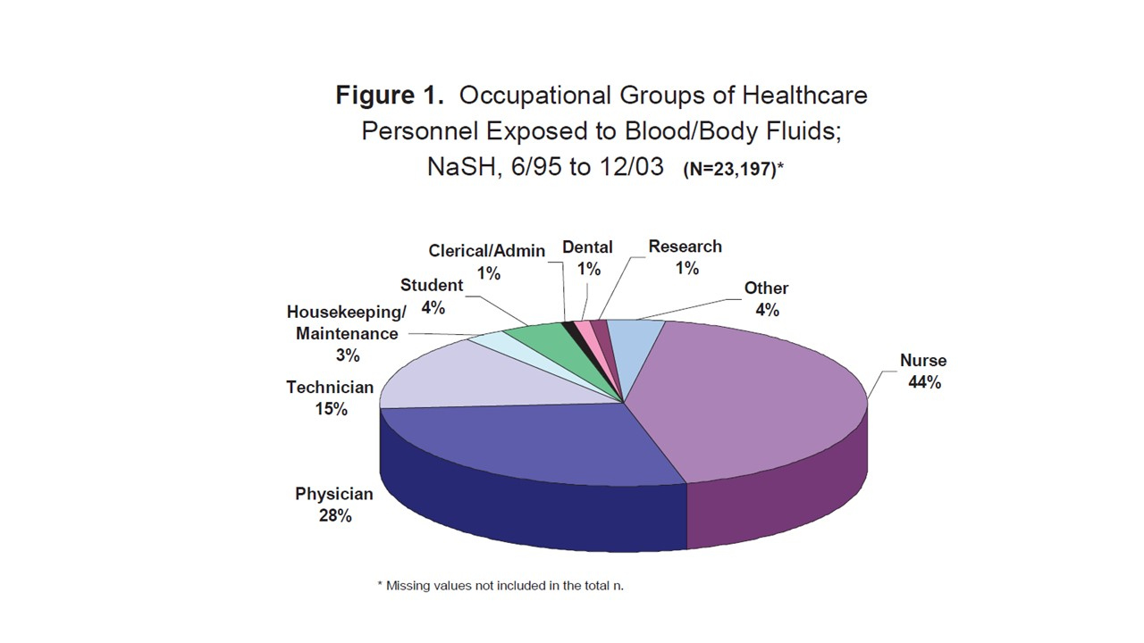
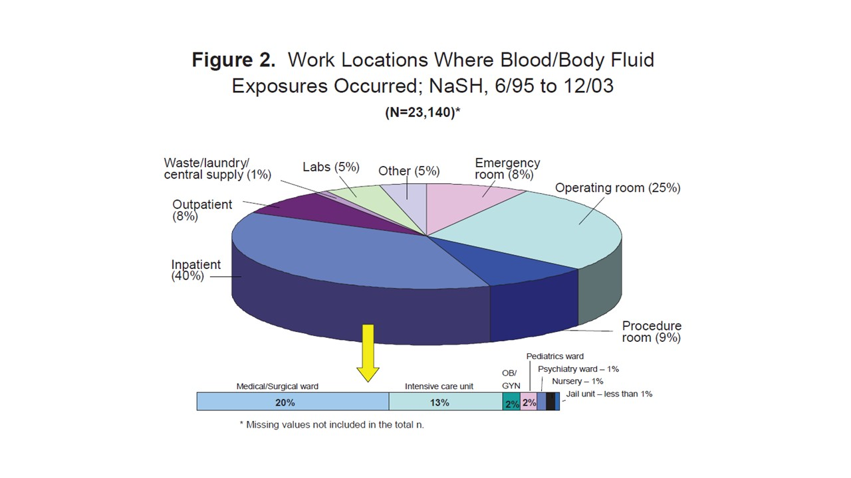
Risk of Exposure
The figure on left shows percent of occupational groups of healthcare workers exposed to blood or body fluids, with nurses (44%), physicians (28%), and technicians (15%) accounting for most of the incidents. The figure on the right shows healthcare work locations where exposures occurred, with inpatient facilities, such as the medical or surgical ward (20%) and intensive care unit (13%), and operating rooms (25%) accounting for the majority of exposure sites. Source: CDC (2008)
Notes:
Source: CDC (2008) Workbook for Designing, Implementing, and Evaluating a Sharps Injury Prevention Program. http://www.cdc.gov/sharpssafety/pdf/sharpsworkbook_2008.pdf
“Who is at Risk of Injury?
Data from NaSH (National Surveillance system for Healthcare workers) show that nurses sustain the highest number of percutaneous injuries. However, other patient-care providers (e.g., physicians, technicians), laboratory staff, and support personnel (e.g., housekeeping staff), are also at risk (Figure 1). Nurses are the predominant occupational group injured by needles and other sharps, in part because they are the largest segment of the workforce at most hospitals. When injury rates are calculated based on the number of employees or full-time equivalent (FTE) positions, some non-nursing occupations have a higher rate of injury (Table 2).
Where, When, and How Do Injuries Occur?
Although sharp devices can cause injuries anywhere within the healthcare environment, NaSH data show that the majority (39%) of injuries occur on inpatient units, particularly medical floors and intensive care units, and in operating rooms (Figure 2). Injuries most often occur after use and before disposal of a sharp device (40%), during use of a sharp device on a patient (41%), and during or after disposal (15%) (CDC unpublished data). There are many possible mechanisms of injury during each of these periods as shown in NaSH data on hollow-bore needle injuries.”

Slide 15
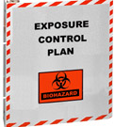
Exposure Control Plan (ECP)
Establish an Exposure Control Plan
Written plan
Review and update plan
Notes:
Establish an exposure control plan
1. Written plan to eliminate or minimize occupational exposures
2. Review and update the plan
a. At least annually
b. Whenever new or modified tasks/procedures affect occupational exposure
c. New/revised employee positions with occupational exposure

Slide 16
Exposure Control Plan (ECP)
Required elements of Exposure Control plan include:
Exposure determination
Schedule and method of implementation
Procedure for evaluation of exposure incidents
Notes:
Required elements [1910.1030(c)(1)(ii)]
1. Exposure determination
a. Identify job classifications with occupational exposure to blood or OPIMs
b. Review tasks and procedures for occupational exposure potential; re-evaluate when new processes or procedures are introduced.
2. Schedule and method of implementation
a. Methods of compliance [29 CFR 1910.1030(d)]
b. HIV and HBV Research Laboratories and Production Facilities [29 CFR 1910.1030(e)]
c. Hepatitis V Vaccination and Post-Exposure Evaluation and Follow-up [29 CFR 1910.1030(f)]
d. Communication of Hazards to Employees [29 CFR 1910.1030(g)]
e. Recordkeeping [29 CFR 1910.1030(h)]
3. Procedure for evaluation of exposure incidents
The ECP must include:
Potential exposure determination
Safe work practices
Changes in technology that reduce/eliminate exposure
Decontaminating equipment
Selecting and using PPE
Handling biohazard waste
Labels and signs
Training requirements
Recordkeeping requirements
Annual review and update

Slide 17
Exposure Control Plan (ECP)
Accessible to employees
Review and update
  Annually
  When new or modified
  tasks/procedures are implemented
Notes:
An exposure control plan is designed to identify in writing, tasks and procedures, as well as job classifications where occupational exposure to blood or other potentially infectious materials occurs. This evaluation should be without regard to personal protective clothing and equipment. It must also set forth the schedule for implementing other provisions of OSHA’s bloodborne pathogen standard and specify the procedure for evaluating circumstances surrounding exposure incidents. The plan must be accessible to employees and available to OSHA. Employers must review and update it at least annually and more often, if necessary, to accommodate workplace changes.
An Exposure Control Plan is important because it helps you protect your workers from exposures to blood and OPIM. By protecting your workers, you also control exposure incident costs.
An Exposure Control Plan is meant to be a "living" document, used as a source of information for answering bloodborne pathogen-related questions and to help ensure exposure control activities are in place. If exposures to blood and OPIM are reasonably anticipated, you are required by the Occupational Safety and Health Administration (OSHA) Bloodborne Pathogens Standard to develop an Exposure Control Plan.
Be sure your facility’s Exposure Control Plan meets OSHA’s criteria:
It must be written specifically for your facility (be site specific)
It must be reviewed and updated at least yearly (to reflect changes such as new worker positions or technology used to reduce exposures to blood or body fluids)
It must be readily available to all workers
You must regularly educate your workers on the uses of the Exposure Control Plan and where it's kept, so it is available when needed.

Slide 18
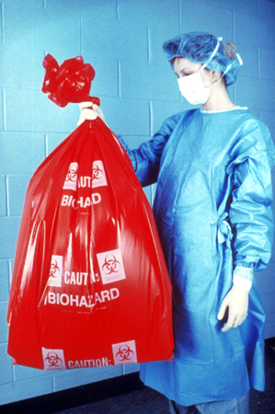
Controlling Exposures
Observe standard precautions, such as:
Treating all blood and bodily fluids as if they are contaminated
Proper cleanup and decontamination
Source: OSHA DTE
Notes:
Bloodborne Pathogen Standard 29 CFR 1910.1030(d)(1) requires:
Employees to observe Universal Precautions to prevent contact with blood or other potentially infectious materials (OPIM).
Under circumstances in which differentiation between body fluid types is difficult or impossible, all body fluids shall be considered potentially infectious materials.
Treat all blood and other potentially infectious materials with appropriate precautions such as:
Use gloves, masks, and gowns if blood or OPIM exposure is anticipated.
Use engineering and work practice controls to limit exposure.
1996, the term Universal Precautions was replaced with the term standard precautions.
What is the difference?
Universal Precautions: This is the practice of avoiding contact with bodily fluids, by means of the wearing of nonporous articles such as gloves, goggles, and face shields. The practice was introduced in 1985-88.
The Centers for Disease Control (CDC) defines Standard Precautions as “ A set of precautions designed to prevent transmission of HIV, Hepatitis B virus (HBV), and other bloodborne pathogens when providing first aid or health care. Under standard precautions, blood and certain body fluids of all patients are considered potentially infectious for HIV, HBV and other bloodborne pathogens.

Slide 19
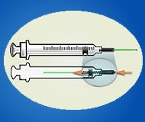
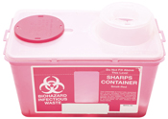

Controlling Exposures
Engineering and work practice controls:
Safer medical devices
Sharps disposal containers
Hand hygiene
Source: OSHA DTE
Source: NIOSH
Source: NIOSH
Notes:
Evaluate available engineering controls (safer medical devices)
Review new devices and technologies annually
Implement appropriate engineering controls/devices, implement new device use, as appropriate and available
Train employees on safe use and disposal
Document evaluation and implementation in ECP
Review, update ECP at least annually
“Studies show that as many as one-third of all sharps injuries occur during disposal. Nurses are particularly at risk, as they sustain the most needlestick injuries. The Centers for Disease Control and Prevention (CDC) estimates that 62 to 88 percent of sharps injuries can be prevented simply by using safer medical devices” (OSHA n.d.)
OSHA (2002) https://www.osha.gov/SLTC/etools/hospital/hazards/infection/infection.html
Use appropriate hand washing. “According to the CDC appropriate hand washing results in a reduced incidence of both nosocomial and community infections. Guidelines from national and international infection prevention and control organizations have repeatedly acknowledged that hand washing is the single most important procedure for preventing infections. Despite this, compliance with hand washing by health care providers is poor.
Hand washing with plain soap (detergents) is effective in removing most transient microbial flora. The components of good hand washing include using an adequate amount of soap, rubbing the hands together to create some friction, and rinsing under running water. The mechanical action of washing and drying removes most of the transient bacteria present.
Washing hands as promptly and thoroughly as possible between patient contacts and after contact with blood, body fluids, secretions, excretions, and equipment or articles contaminated by them is an important component of infection control and isolation precautions.”

Slide 20
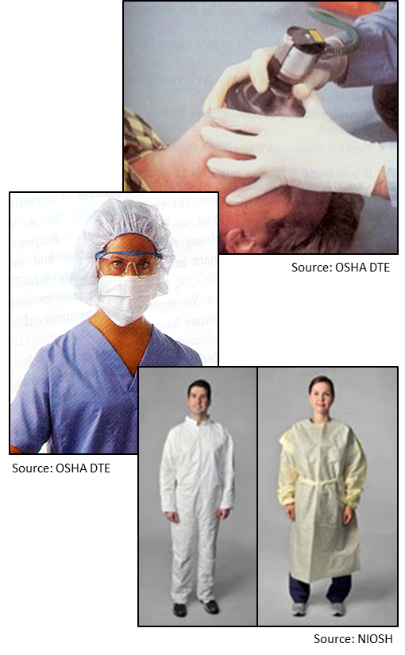
Controlling Exposures
PPE examples:
Gloves
Masks
Aprons/Smocks/Gowns
Face shields
Mouthpieces
Safety glasses
CPR pocket masks
Notes:
Source: OSHA hospital e-tool https://www.osha.gov/SLTC/etools/hospital/hazards/ppe/ppe.html
Some general PPE Guidelines include, but not limited to:
Wear gloves, when handling chemicals and/or body fluids.
Wear safety shoes/boots/covers if hazardous substance is likely to splash.
Wear an apron/gown/coveralls- if hazardous substance is likely to splash.
Use a respirator: when hazardous substance is airborne such as tuberculosis.
Wear hearing protection: for loud noises such as from equipment.
Remove PPE carefully to avoid contaminating yourself.
Dispose of PPE in designated containers before leaving area.

Slide 21
Controlling Exposures
Employer’s responsibilities:
Perform hazard assessment
Identify and provide appropriate PPE to employee at no cost
Train employees on use and care
Maintain/replace PPE
Review, update, evaluate PPE program
Notes:
Source: OSHA Publication #3151 https://www.osha.gov/Publications/osha3151.html
To ensure the greatest possible protection for employees in the workplace, the cooperative efforts of both employers and employees will help in establishing and maintaining a safe and healthful work environment.
In general, employers are responsible for:
Performing a "hazard assessment" of the workplace to identify and control physical and health hazards.
Identifying and providing appropriate PPE for employees.
Training employees in the use and care of the PPE.
Maintaining PPE, including replacing worn or damaged PPE.
Periodically reviewing, updating and evaluating the effectiveness of the PPE program.

Slide 22
Controlling Exposures
PPE selection
  Safe design and
  construction
  Fit comfortably
Required PPE training
  When it is necessary
  What kind is necessary
  Proper donning, adjusting, wearing, doffing
  Limitations
  Proper care, maintenance, useful life, disposal
Source: CDC
Notes:
Source: OSHA Publication #3151 https://www.osha.gov/Publications/osha3151.html
When engineering, work practice, and administrative controls are not feasible or do not provide sufficient protection, employers must provide personal protective equipment to their workers and ensure its proper use.
Employers are also required to train each worker required to use personal protective equipment to know:
When it is necessary
What kind is necessary
How to properly put it on, adjust, wear and take it off
The limitations of the equipment
Proper care, maintenance, useful life, and disposal of the equipment

Slide 23
Controlling Exposures
Employee’s responsibilities:
Properly wear PPE
Attend training
Care for, clean, and maintain
Notify when repairs/replacement needed
Notes:
Source: OSHA Publication #3151 https://www.osha.gov/Publications/osha3151.html
To ensure the greatest possible protection for employees in the workplace, the cooperative efforts of both employers and employees will help in establishing and maintaining a safe and healthful work environment.
In general, employees are responsible for:
Properly wear PPE,
Attend training sessions on PPE,
Care for, clean and maintain PPE, and
Inform a supervisor of the need to repair or replace PPE.

Slide 24

Controlling Exposures
Housekeeping:
Written schedule for cleaning and decontamination
Picking up broken glass
  Not picked up by hands
  Mechanical means only
Source: OSHA DTE
Notes:
All equipment and environmental and working surfaces shall be cleaned and decontaminated after contact with blood or other potentially infectious materials [29 CFR 1910.1030(d)(4)(ii)].
Some equipment, if grossly contaminated, must be cleaned with a soap and water solution prior to decontamination, as some anti-microbial products will not work in the presence of blood, which interferes with the sterilizing process.
Protective coverings, such as plastic wrap or aluminum foil, shall be removed and replaced as soon as possible, when they become overtly contaminated, or at the end of a work shift if they may have become contaminated during the shift [29 CFR 1910.1030(d)(4)(ii)(B)].
All bins, pails, cans, and similar receptacles intended for reuse which have a reasonable likelihood for becoming contaminated with blood or other potentially infectious material shall be inspected and decontaminated on a regularly scheduled basis and cleaned and decontaminated immediately or as soon as feasible upon visible contamination [29 CFR 1910.1030(d)(4)(ii)(C)].
Broken glassware which may be contaminated, must not be picked up directly with hands; use mechanical means, such as use a brush and dustpan, tongs or forceps.

Slide 25
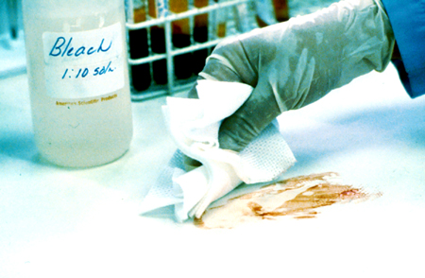
Controlling Exposures
Clean-up and decontamination:
Wear protective gloves
Use appropriate disinfectant
Clean and disinfect
contaminated equipment
and work surfaces
Thoroughly wash up
immediately after exposure
Properly dispose of contaminated PPE, towels, rags, etc.
Source: OSHA DTE
Notes:
“What does OSHA currently accept as "appropriate" disinfectants to prevent the spread of HIV and HBV?
A review of the initial intent of the Bloodborne Pathogens Standard that specifically deals with the cleaning of contaminated work surfaces, i.e., 1910.1030(d)(4)(ii)(A), reveals that OSHA intended to provide a performance-based provision that would allow for future development of "appropriate disinfectant" products. OSHA has reviewed the information on the disinfectants and has reconsidered its position on EPA-registered disinfectants that are labeled as effective against HBV and HIV. OSHA's current stance is that EPA-registered disinfectants for HIV and HBV meet the requirement in the standard and are "appropriate" disinfectants to clean contaminated surfaces, provided such surfaces have not become contaminated with agent(s) or volumes of or concentrations of agent(s) for which higher level disinfection is recommended.
It is important to emphasize the EPA-approved label section titled "SPECIAL INSTRUCTIONS FOR CLEANING AND DECONTAMINATION AGAINST HIV-1 AND HBV Of SURFACES\OBJECTS SOILED WITH BLOOD\BODY FLUIDS." On the labels that OSHA has seen, these instructions require:
personal protection devices for the worker performing the task;
that all the blood must be cleaned thoroughly before applying the disinfectant;
that the disposal of the infectious waste is in accordance with federal, state, or local regulations; and
that the surface is left wet with the disinfectant for 30 seconds for HIV-1 and 10 minutes for HBV.“
(OSHA: https://www.osha.gov/html/faq-bbp.html)

Slide 26
Controlling Exposures
Regulated waste disposal:
  Dispose of regulated waste in closable, leak-proof red or biohazard labeled bags or containers
  Dispose of contaminated sharps in closable, puncture-resistant, leak-proof, red or
Source: OSHA DTE
Notes:
The Bloodborne Pathogens standard uses the term, "regulated waste," to refer to the following categories of waste which require special handling: (1) liquid or semi-liquid blood or OPIM; (2) items contaminated with blood or OPIM and which would release these substances in a liquid or semi-liquid state if compressed; (3) items that are caked with dried blood or OPIM and are capable of releasing these materials during handling; (4) contaminated sharps; and (5) pathological and microbiological wastes containing blood or OPIM.
It is the employer's responsibility to determine the existence of regulated waste. This determination is not based on actual volume of blood, but rather on the potential to release blood (e.g., when compacted in a waste container). If OSHA determines, on a case-by-case basis, that sufficient evidence of regulated waste exists, either through observation (e.g., a pool of liquid in the bottom of a container, dried blood flaking off during handling), or based on employee interviews, citations may be issued if the employer does not comply with the provisions of the standard on regulated waste.
Regulated waste shall be placed in containers which are:
Closable;
Constructed to contain all contents and prevent leakage of fluids during handling, storage, transport or shipping;
Labeled or color-coded in accordance with paragraph (g)(1)(i) of the standard; and
Closed before removal to prevent spillage or protrusion of contents during handling, storage, transport, or shipping.
If outside contamination of the regulated waste container occurs, it shall be placed in a second container. The second container shall be:
Closable;
Constructed to contain all contents and prevent leakage of fluids during handling, storage, transport, or shipping;
Labeled or color-coded in accordance with paragraph (g)(1)(i) of the standard; and
Closed before removal to prevent spillage or protrusion of contents during handling, storage, transport, or shipping.
Disposal of all regulated waste shall be in accordance with applicable regulations of the United States, States and Territories, and political subdivisions of States and Territories.

Slide 27
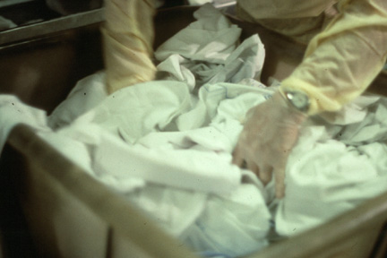
Controlling Exposures
Laundry
  Contaminated laundry must be bagged or containerized at the location where it was used.
Source: OSHA DTE
Notes:
Contaminated laundry means laundry which has been soiled with blood or other potentially infectious materials or may contain sharps.
Contaminated laundry shall be handled as little as possible with a minimum of agitation. Contaminated laundry shall be bagged or containerized at the location where it was used and shall not be sorted or rinsed in the location of use.
Other requirements include:
a. Contaminated laundry shall be placed and transported in bags or containers labeled or color-coded in accordance with paragraph (g)(1)(i) of the standard. When a facility utilizes Universal/standard Precautions in the handling of all soiled laundry, alternative labeling or color-coding is sufficient if it permits all employees to recognize the containers as requiring compliance with Universal/standard Precautions.
b. Whenever contaminated laundry is wet and presents a reasonable likelihood of soak-through or leakage from the bag or container, the laundry shall be placed and transported in bags or containers which prevent soak-through and/or leakage of fluids to the exterior.
The employer shall ensure that employees who have contact with contaminated laundry wear protective gloves and other appropriate personal protective equipment.
When a facility ships contaminated laundry off-site to a second facility which does not utilize Universal Precautions in the handling of all laundry, the facility generating the contaminated laundry must place such laundry in bags or containers which are labeled or color-coded in accordance with paragraph (g)(1)(i) of the standard.
Employees are not permitted to take their protective equipment home and launder it. It is the responsibility of the employer to provide, launder, clean, repair, replace, and dispose of personal protective equipment.

Slide 28

Controlling Exposures
Training:
Who
  All employees with
  occupational exposure to blood
  or other potentially infectious material (OPIM)
  Employees who are trained in first aid and CPR
No cost; during working hours
When
  Initial assignment
  Annually; or with new/modified tasks
Source: OSHA DTE
Notes:
All employees with occupational exposure must receive initial and annual training. In addition, training must be provided when changes (e.g., modified/new tasks or procedures) affect a worker’s occupational exposure.
Part-time and temporary employees are covered and are also to be trained on company time.
The training program shall contain at a minimum the following elements:
1. An accessible copy of the regulatory text of this standard and an explanation of its contents;
2. A general explanation of the epidemiology and symptoms of bloodborne diseases;
3. An explanation of the modes of transmission of bloodborne pathogens;
4. n explanation of the employer's exposure control plan and the means by which the employee can obtain a copy of the written plan;
5. An explanation of the appropriate methods for recognizing tasks and other activities that may involve exposure to blood and other potentially infectious materials;
6. An explanation of the use and limitations of methods that will prevent or reduce exposure including appropriate engineering controls, work practices, and personal protective equipment;
7. Information on the types, proper use, location, removal, handling, decontamination and disposal of personal protective equipment;
8. An explanation of the basis for selection of personal protective equipment;
9. Information on the hepatitis B vaccine, including information on its efficacy, safety, method of administration, the benefits of being vaccinated, and that the vaccine and vaccination will be offered free of charge;
10. Information on the appropriate actions to take and persons to contact in an emergency involving blood or other potentially infectious materials;
11. An explanation of the procedure to follow if an exposure incident occurs, including the method of reporting the incident and the medical follow-up that will be made available;
12. Information on the post-exposure evaluation and follow-up that the employer is required to provide for the employee following an exposure incident;
13. Explanation of the signs and labels and/or color coding required by paragraph (g)(1); and
14. An opportunity for interactive questions and answers with the person conducting the training session.
The person conducting the training is required to be knowledgeable in the subject matter covered by the elements in the training program and be familiar with how the course topics apply to the workplace that the training will address. The trainer must demonstrate expertise in the area of occupational hazards of bloodborne pathogens.

Slide 29
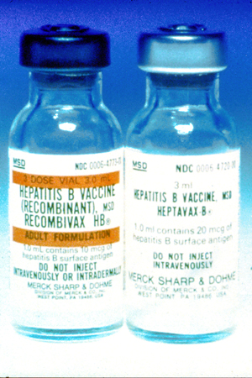
Controlling Exposures
Hepatitis B vaccination:
Offered to all potentially exposed employees
Provided at no cost to employees (within 10 days to employees with occupational exposure)
Declination form
Source: OSHA DTE
Notes:
The hepatitis B vaccination series must be made available to all employees who have occupational exposure. The employer does not have to make the hepatitis B vaccination available to employees who have previously received the vaccination series, who are already immune as their antibody tests reveal, or for whom receiving the vaccine is contraindicated for medical reasons.
The hepatitis B vaccination must be made available within 10 working days of initial assignment, after appropriate training has been completed.
All medical evaluations and procedures, including the hepatitis B vaccine and vaccination series, are to be provided according to the current recommendations of the U.S. Public Health Service (USPHS).
If an employee declines the hepatitis B vaccination, the employer must ensure that the employee signs a hepatitis B vaccine declination. The declination form is found in Appendix A of the standard.
Employees have the right to refuse the hepatitis B vaccine and/or any post-exposure evaluation and follow-up. Note, however, that the employee needs to be properly informed of the benefits of the vaccination and post-exposure evaluation through training. The employee also has the right to decide to take the vaccination at a later date if he or she so chooses. The employer must make the vaccination available at that time.
The responsibility lies with the employer to make the hepatitis B vaccine and vaccination, including post-exposure evaluation and follow-up, available at no cost to the employees.

Slide 30
Controlling Exposures
No vaccinations for:
Hepatitis C
HIV
Notes:
At the present time there are no vaccinations available for Hepatitis C and HIV.

Slide 31
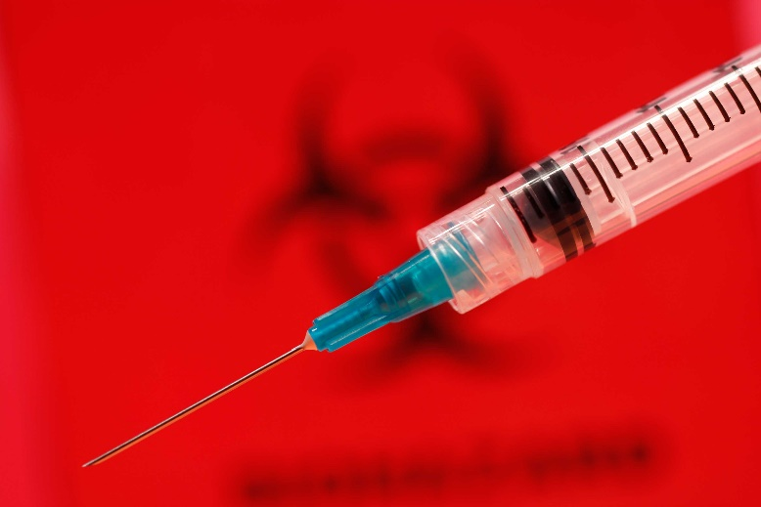
When Exposure Occurs
Exposure incident:
Specific eye, mouth, or other mucous membrane, non-intact skin, parenteral contact with blood or OPIM that results from the performance of an employee’s duties.
Source: CDC
Notes:
An exposure incident is a specific eye, mouth, other mucous membrane, non-intact skin, or parenteral contact with blood or other potentially infectious materials (OPIM), as defined in the standard that results from the performance of a worker’s duties.

Slide 32
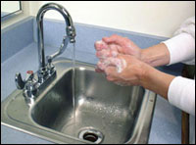
When Exposure Occurs
Immediate actions
  Wash exposed area with soap and water
  Flush splashes to nose, mouth, or skin with water
  Irrigate eyes with water and saline
Source: OSHA
Notes:
If exposed to blood or OPIM,
1. Wash needlesticks and cuts with soap and water
2. Flush splashes to the nose, mouth, or skin with water
3. Irrigate eyes with clean water, saline, or sterile irrigants.
No scientific evidence shows that using antiseptics or squeezing the wound will reduce the risk of transmission of a bloodborne pathogen. Using a caustic agent such as bleach is not recommended.
Report the exposure to the person(s) responsible for managing exposures. Prompt reporting is essential because, in some cases, postexposure treatment may be recommended and it should be started as soon as possible. Discuss the possible risks of acquiring HBV, HCV, and HIV and the need for postexposure treatment with the provider managing your exposure. You should have already received hepatitis B vaccine, which is extremely safe and effective in preventing HBV infection.

Slide 33
When Exposure Occurs
Report exposure immediately
Direct employee to healthcare professional for treatment
Notes:
If the exposure is the result of a needlestick or cut, encourage bleeding and wash immediately with soap and water.
The employee must immediately report the exposure incident to the supervisor. (Time is of the essence. Results can often be improved by prompt action.) The supervisor will immediately refer the potentially exposed individual to the appropriate healthcare professional for post exposure and evaluation who in turn will evaluate and treat the individual based on guidelines set forth in OSHA’s bloodborne pathogen standard.

Slide 34
When Exposure Occurs
Confidential medical evaluation and follow-up
  Route(s) of exposure and circumstances
  Source individual
  Collect/test blood for HBV and HIV serological status
  Post exposure prophylaxis
  (when medically indicated)
  Counseling
  Evaluation
Notes:
Source: OSHA Hospital eTool: https://www.osha.gov/SLTC/etools/hospital/hazards/bbp/bbp.html
Immediately make available to exposed worker a confidential medical evaluation and follow-up:
1. Document route(s) of exposure and circumstances of exposure incident
2. Identify and document source individual, unless infeasible or prohibited
3. Collect and test blood for HBV and HIV serological status
4. When medically indicated, U.S. Public Health Service recommends post-exposure prophylaxis
5. Counseling
6. Evaluation of reported illness

Slide 35
What Questions Do You Have?
?

Slide 36
Knowledge Check
Bloodborne pathogens can be transmitted by ___.
  sexual intercourse or intravenous drug use
  rubbing an eye after coming in contact with potentially infectious material
  potentially infectious material coming in contact with inflamed acne or sunburn blisters
  all of the above
Answer: d. All of the above

Slide 37
Knowledge Check
Employees should use PPE when ____.
  there is a reasonable anticipation of contact with blood or OPIM
  cleaning up spills
  responding to an emergency
  all of the above
Answer: d. all of the above

Slide 38
Knowledge Check
Which of the following is an example of a work practice control?
  Spill kits
  Accessible handwashing stations
  Proper decontamination of spill areas
  Red hazardous waste bags
Answer: c. Proper decontamination of spill areas

Slide 39
Knowledge Check
Which of the following is a standard precaution for workers exposed to bloodborne pathogens?
  Treat all liquids as hazardous for HIV
  Treat all blood and bodily fluids of patients as potentially infectious materials
  Test all blood and unknown bodily fluids for
  HIV after spills
  Label unknown liquids with hazard signs
Answer: b. Treat all blood and bodily fluids of
patients as potentially infectious
materials

Slide 40
Knowledge Check
Hepatitis B is an inflammation of which body organ?
  Kidney
  Lungs
  Larynx
  Liver
Answer: d. Liver

Slide 41
Knowledge Check
In the event of an exposure incident, which following action should be taken first?
  Notify appropriate personnel
  Wash the area thoroughly
  Seek medical treatment
  Complete an incident or accident report
Answer: b. Wash the area thoroughly

Slide 42
Knowledge Check
Which of the following actions can help prevent exposure to bloodborne pathogens?
  Wearing latex gloves
  Wearing goggles
  Washing hands
  All of the above
Answer: d. All of the above

Slide 43
Knowledge Check
A vaccine is only available for which of the following major bloodborne pathogen viruses?
  HIV
  Hepatitis B
  Hepatitis C
  No vaccines are available for any of the three major BBP viruses
Answer: b. Hepatitis B

Slide 44
Knowledge Check
Which of the following are potential routes of entry for bloodborne pathogens?
  Mucous membranes of the eyes, nose, and mouth
  Non-intact skin
  Penetration by a contaminated sharp object
  All of the above
Answer: d. All of the above

